Slide 1
COMMUNICATION
IN POSTSECONDARY EDUCATION
Presented by Toni Bastian, MA

Slide 2
WRITE YOUR OWN DEFINITION OF COMMUNICATION
Notes:
🍐 This is a Pear Deck Text Slide
🍐 To edit the type of question, go back to the "Ask Students a Question" in the Pear Deck sidebar.

Slide 3
WHAT IS COMMUNICATION?
Communication is giving, receiving or exchanging ideas, information, signals or messages through appropriate media, enabling individuals or groups to persuade, to seek information, to give information or to express emotions. This broad definition includes body-language, skills of speaking and writing.
Source: Google

Slide 4
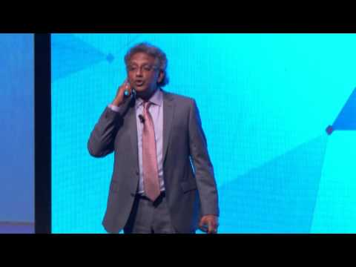
CULTURAL COMMUNICATION
Dr. Tom Verghese is a leading authority in cultural intelligence.
Source: The Centre for Global Inclusion

Slide 5
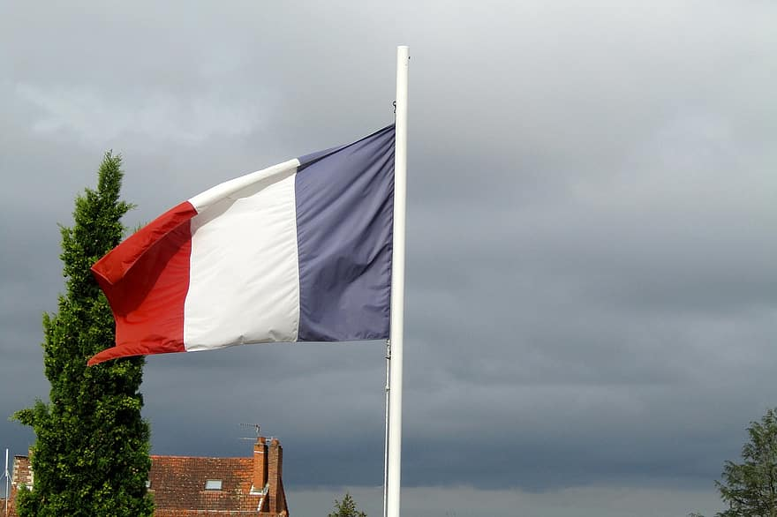
HIGH CONTEXT vs. LOW CONTEXT CULTURES
HIGH CONTEXT CULTURES: use communication that focuses on underlying context, meaning, and tone in the message, and not just the words themselves.
LOW CONTEXT CULTURES: expect communication to be explicitly stated so there’s no risk of confusion.
Source: United Language Group

Slide 6
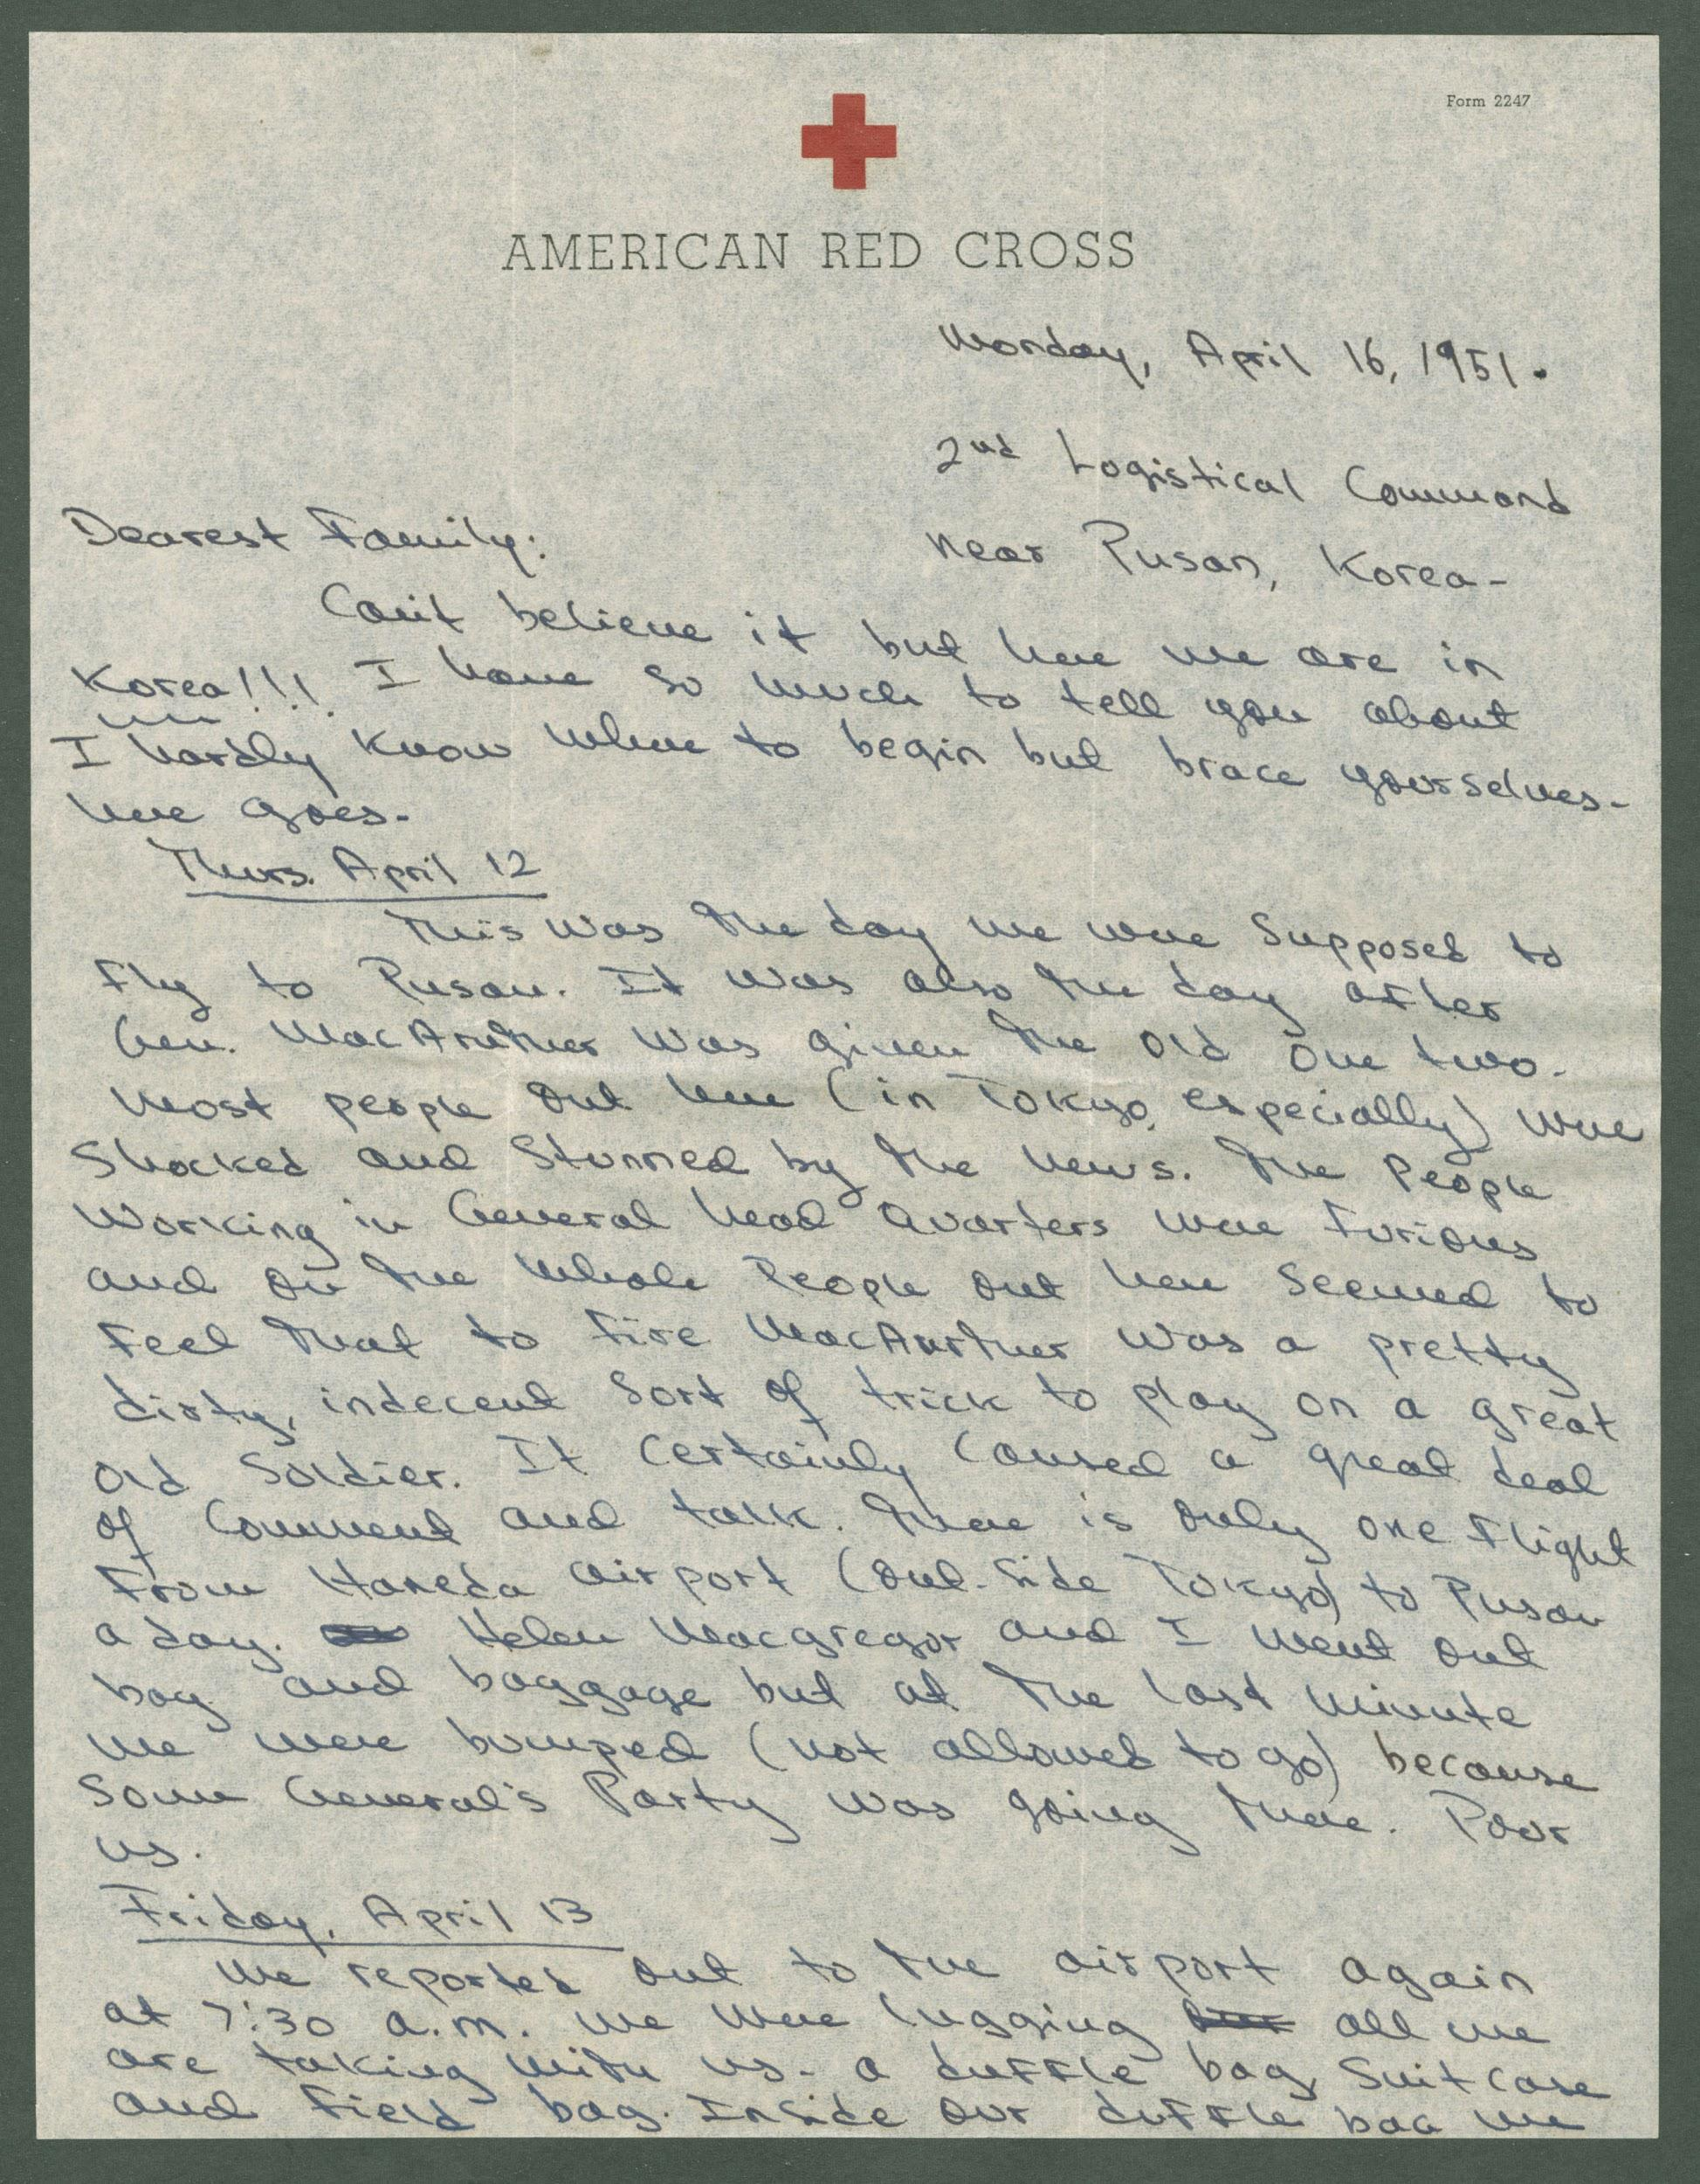
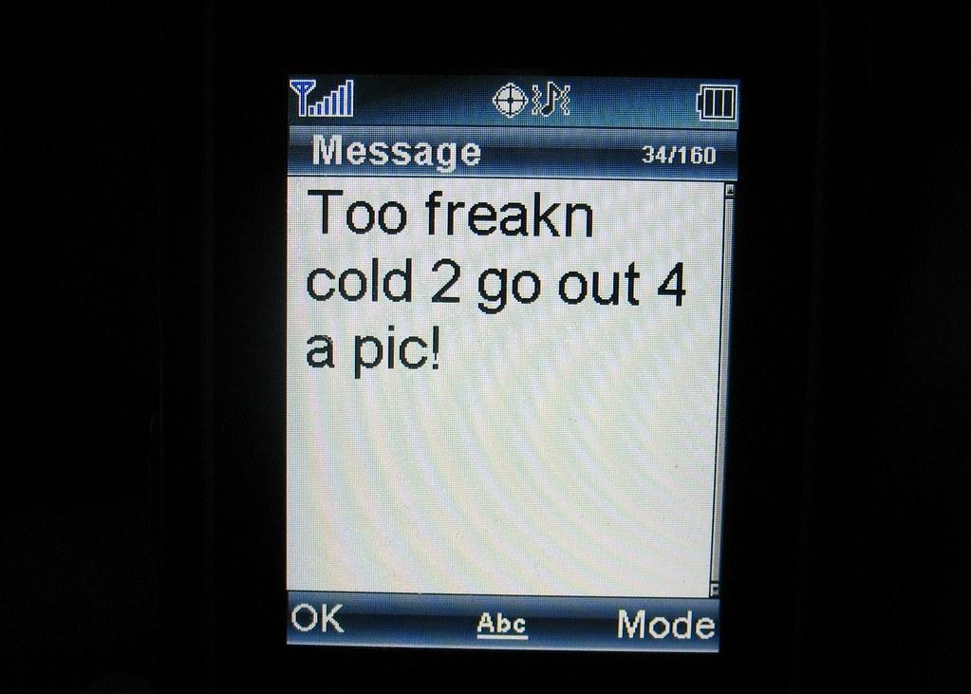
HIGH CONTEXT vs. LOW CONTEXT COMMUNICATION
HIGH CONTEXT CULTURES: prefer oral communication, longer forms of communication that don’t always focus on basic questions.
LOW CONTEXT CULTURES: favor written communication, emails, texts, online messaging - want basic questions answered.
Source: United Language Group

Slide 7
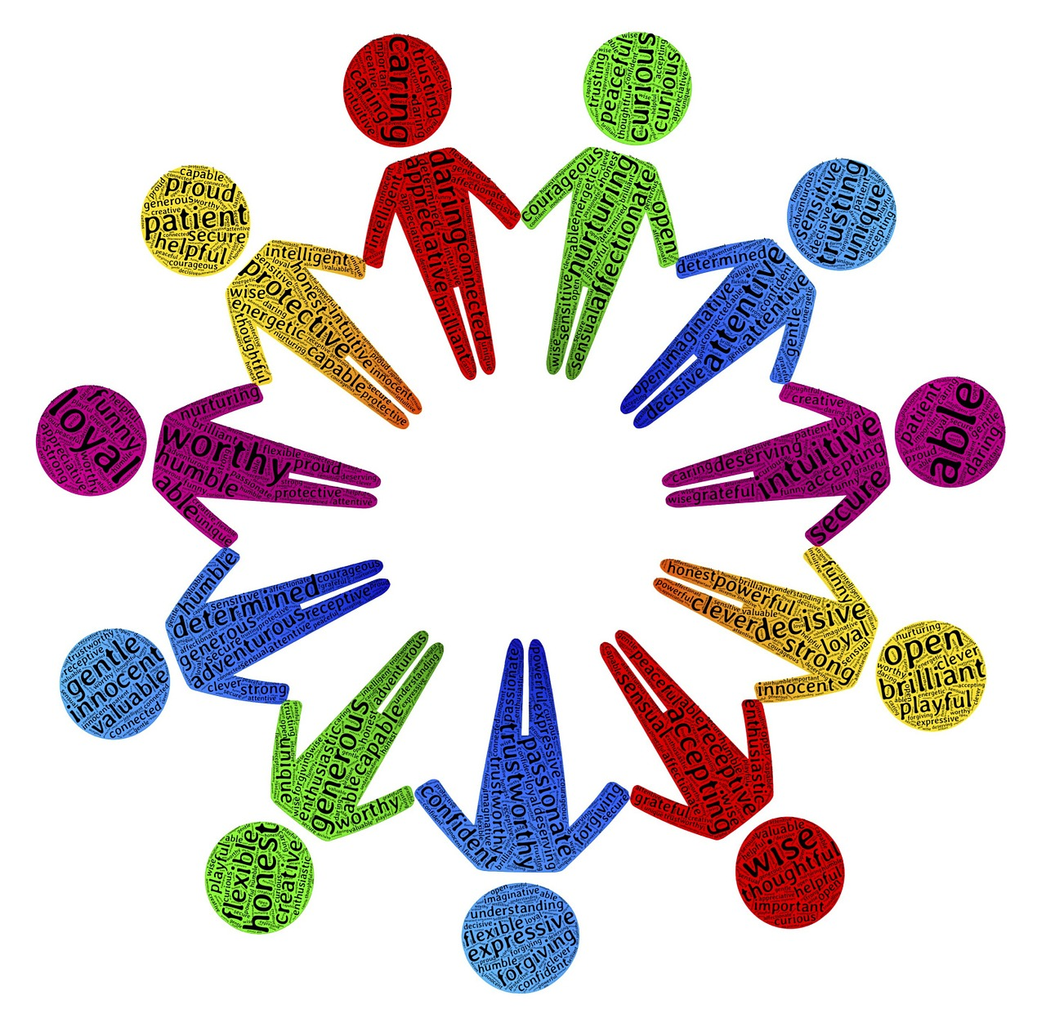
HIGH CONTEXT vs. LOW CONTEXT CHARACTERISTICS
HIGH CONTEXT CULTURES: similarity is important, so messages can be contextualized by assuming an audience will think in the same way and follow the underlying message implicit in someone’s speech or writing.
LOW CONTEXT CULTURES: are diverse and focus on the individual instead of the group. Communication must be basic enough to allow for as many people to
understand it as possible.
Source: United Language Group
Source: United Language Group

Slide 8
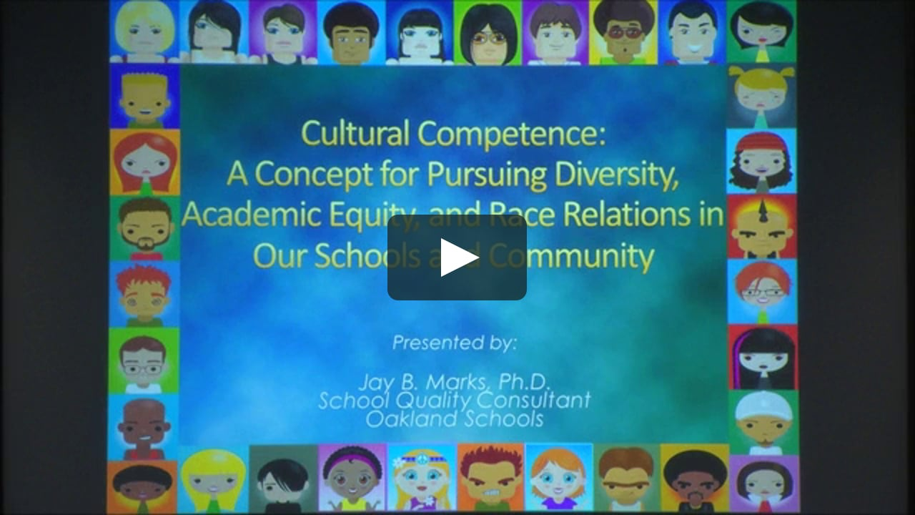
CULTURAL COMPETENCE
The social awareness that everyone is not like I am, that their different cultures and backgrounds affect how they think and behave, and that this awareness allows me to behave appropriately and perform effectively in culturally diverse environments.
Source: Global Pathways: Cultural
Competence Curriculum Module

Slide 9
CULTURAL COMPETENCE
In order to be culturally competent, and interact effectively with people of different cultures, we have to be self-reflective.
Source: Global Pathways: Cultural
Competence Curriculum Module

Slide 10
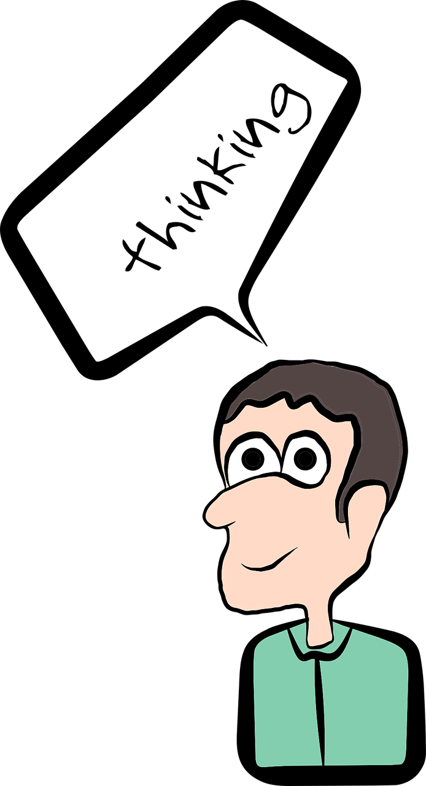
CULTURAL COMPETENCE
Please reflect honestly on the following questions:
Am I aware of my own cultural worldview?
What is my cultural worldview?
Source: Global Pathways: Cultural
Competence Curriculum Module

Slide 11
CULTURAL COMPETENCE
Please reflect honestly on the following questions:
2. What is my attitude about cultural differences?
Does that attitude change depending on the situation I’m in?
Source: Global Pathways: Cultural
Competence Curriculum Module

Slide 12
CULTURAL COMPETENCE
Please reflect honestly on the following questions:
3. Do I have knowledge of different cultural practices and worldviews?
Is that knowledge superficial or deep?
Source: Global Pathways: Cultural
Competence Curriculum Module

Slide 13
CULTURAL COMPETENCE
Please reflect honestly on the following questions:
4. Do I have knowledge of cross-cultural skills?
In other words, do I know how to effectively engage with people from other cultures?
Source: Global Pathways: Cultural
Competence Curriculum Module

Slide 14
THE CULTURAL COMPETENCY CONTINUUM: KNOWLEDGE, BEHAVIORS, AND DISPOSITIONS FOR EDUCATORS
Step 1: Awaken and Assess
Step 2: Apply and Act
Step 3: Analyze and Align
Step 4: Advocate and Lead
Source: The Case for Cultural Competency

Slide 15
THE CULTURAL COMPETENCY CONTINUUM FOR EDUCATORS
Step 1: Awaken and Assess - choose one statement that you most identify with.
I am aware of my own values, beliefs, stereotypes, and biases.
I affirm and respect cultures other than my own.
I actively seek to foster meaningful relationships with people of different cultural and racial identities.
I recognize the various kinds of racism.
I understand the varied cultural values of my colleagues and students.
Source: The Case for Cultural Competency
Notes:
🍐 This is a Pear Deck Draggable™ Slide.
🍐 To edit the type of question, go back to the "Ask Students a Question" in the Pear Deck sidebar.

Slide 16
THE CULTURAL COMPETENCY CONTINUUM FOR EDUCATORS
Step 2: Apply and Act - choose one statement that you most identify with.
I help make all cultural groups feel welcomed and valued
I regularly assess if my students feel respected and valued in class by asking them for feedback.
I use communication skills to facilitate, manage, and participate in discussions on race, culture, and difference.
I am intentional about incorporating relevant cultural knowledge into instruction, curriculum, resources, learning environment, outreach, and assessment.
I regularly examine student data relative to gender, race, ethnicity, and language to monitor and manage equitable access and support services.
Source: The Case for Cultural Competency
Notes:
🍐 This is a Pear Deck Draggable™ Slide.
🍐 To edit the type of question, go back to the "Ask Students a Question" in the Pear Deck sidebar.

Slide 17
THE CULTURAL COMPETENCY CONTINUUM FOR EDUCATORS
Step 3: Analyze and Align - choose one statement that you most identify with.
I can effectively challenge racism, inequity, or discriminatory practices in a professional and proactive manner.
I own the responsibility for building an authentically inclusive and just classroom and school environment.
I work with my colleagues to institutionalize our learning and implement agreed-on goals and vision.
I have critiqued various schoolwide policies and practices and worked to reduce or eliminate any that my perpetuate inequitable outcomes.
I know the legal issues surrounding racism, bullying, and fostering a hostile environment, and I examine policies and procedures to ensure my practices are fair and legally defensible.
Source: The Case for Cultural Competency
Notes:
🍐 This is a Pear Deck Draggable™ Slide.
🍐 To edit the type of question, go back to the "Ask Students a Question" in the Pear Deck sidebar.

Slide 18
THE CULTURAL COMPETENCY CONTINUUM FOR EDUCATORS
Step 4: Advocate and Lead - choose one statement that you most identify with.
I empower all stakeholders and encourage open dialogue and dissent.
I identify barriers that prevent certain populations from full access to services and have taught colleagues ways to remove them.
I confront racism when I see it.
I advocate for cultural competency and social justice effectively and professionally.
I am a brave equity warrior (and I have the scars to prove it).
Source: The Case for Cultural Competency
Notes:
🍐 This is a Pear Deck Draggable™ Slide.
🍐 To edit the type of question, go back to the "Ask Students a Question" in the Pear Deck sidebar.

Slide 19
CULTURALLY COMPETENT TEACHING AND LEARNING
Critical Reflection - culturally responsive teaching engages students in self-awareness activities that lead to reflection on cultural assumptions.
Source: Higher Ed Teaching Strategies

Slide 20
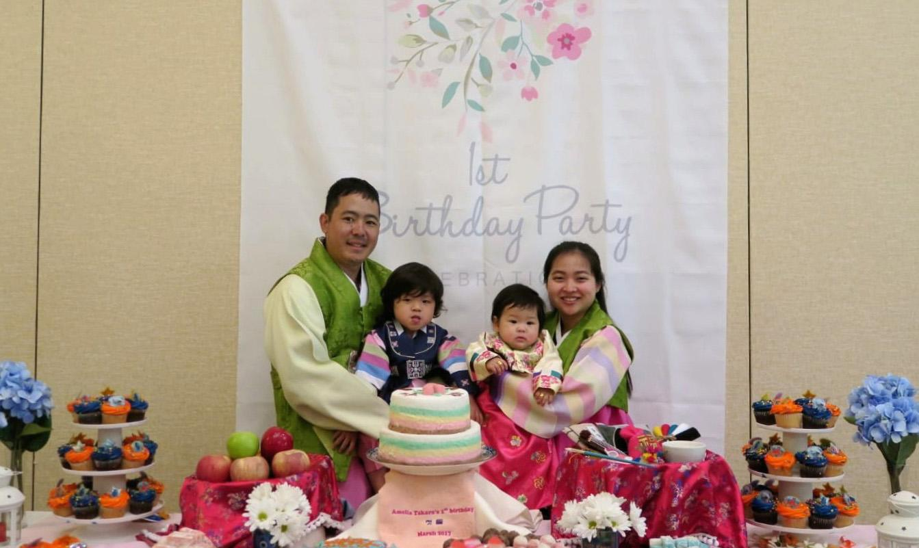
CULTURALLY COMPETENT TEACHING AND LEARNING
2. Cultural Backgrounds - experiences based on various traditions, norms, and values inform ways of knowing and learning.
Source: Higher Ed Teaching Strategies

Slide 21
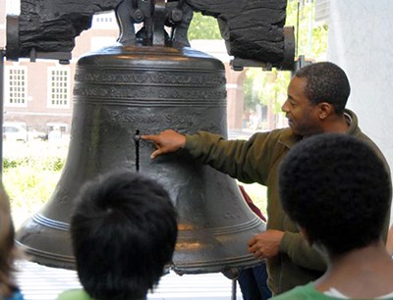
CULTURALLY COMPETENT TEACHING AND LEARNING
3. Individual Learners - in addition to pedagogical and subject matter knowledge, competent instructors relate well to their students.
Source: Higher Ed Teaching Strategies

Slide 22
CULTURALLY COMPETENT TEACHING AND LEARNING
4. Intercultural communication skills - culturally competent instructors are willing to learn from their students.
Source: Higher Ed Teaching Strategies

Slide 23
CULTURALLY COMPETENT TEACHING AND LEARNING
5. Intentionally Structured Environments - perspective-taking behavior requires an understanding of norms, values, and traditions that have informed the other’s worldview and learning behaviors.
Source: Higher Ed Teaching Strategies

Slide 24
CULTURAL QUOTIENT (CQ)
Helps us understand and communicate with people from other cultures effectively.
Source: Global Pathways: Cultural
Competence Curriculum Module

Slide 25
CULTURAL QUOTIENT (CQ)
Is one’s ability to recognize cultural differences through knowledge and mindfulness, and behave appropriately when facing people from other cultures.
Source: Global Pathways: Cultural
Competence Curriculum Module

Slide 26
CULTURAL QUOTIENT (CQ)
Is critical to improving culturally diverse situations:
Enhances sensitivity to cultural differences.
Reduces use of overly simplistic stereotypes.
Enhances adjustment and relationships in multicultural contexts.
Improves decision-making and work performance in multicultural contexts.
Source: Global Pathways: Cultural
Competence Curriculum Module

Slide 27
HOW CAN INSTRUCTORS CONNECT WITH THEIR STUDENTS?
https://youtu.be/OtZ0HtamJ7E
Amanda Rose teaches high school students.

Slide 28
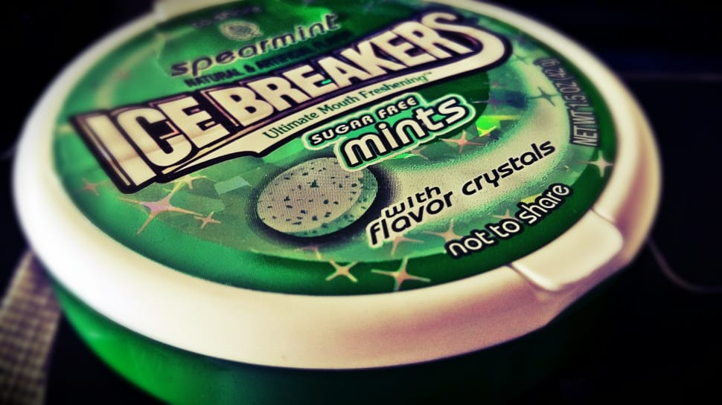
HOW CAN INSTRUCTORS CONNECT WITH THEIR STUDENTS?
Things to avoid in ICEBREAKERS
Do not ask students to take massive social risks with people they barely know.
Do not ask questions that won’t help the students become familiar with one another.
Do not use an activity that is cheesy.
Source: Cult of
Pedagogy

Slide 29
HOW CAN INSTRUCTORS CONNECT WITH THEIR STUDENTS?
ICEBREAKERS THAT WORK:
Blobs and Lines
Source: Cult of
Pedagogy

Slide 30
HOW CAN INSTRUCTORS CONNECT WITH THEIR STUDENTS?
ICEBREAKERS THAT WORK:
2. Concentric Circles
Source: Cult of
Pedagogy

Slide 31
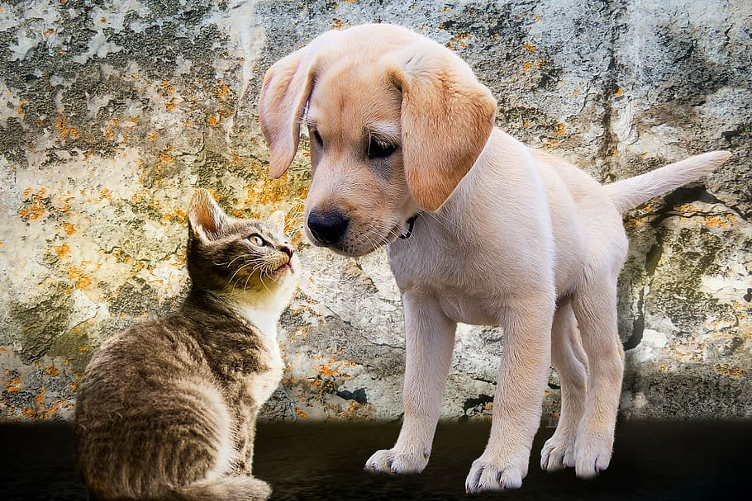
HOW CAN INSTRUCTORS CONNECT WITH THEIR STUDENTS?
ICEBREAKERS THAT WORK:
3. This or That
Source: Cult of
Pedagogy
Source: Cult of
Pedagogy

Slide 32
STUDENT SURVEYS
Michel DeGraff is a college instructor.
https://youtu.be/fh1bvrJN4Fc

Slide 33
STUDENT SURVEYS:
QUESTIONNAIRES
GOALS
-what are your career goals
-what do you see yourself doing in the next 5-10 years
-how do you plan to get to where you want to be 5-10 years from now
Source: Norman Herr, Ph.D
CSU, Northridge

Slide 34
STUDENT SURVEYS:
QUESTIONNAIRES
2. FAMILY AND HOME ENVIRONMENT
-how many brothers and sisters do you have
-how do you get to school
-what language do you speak at home
Source: Norman Herr, Ph.D
CSU, Northridge

Slide 35
STUDENT SURVEYS:
QUESTIONNAIRES
3. PERSONAL INFORMATION
-do you know anyone in this class
-what do you enjoy doing in your free time
-what are you most proud of
Source: Norman Herr, Ph.D
CSU, Northridge

Slide 36
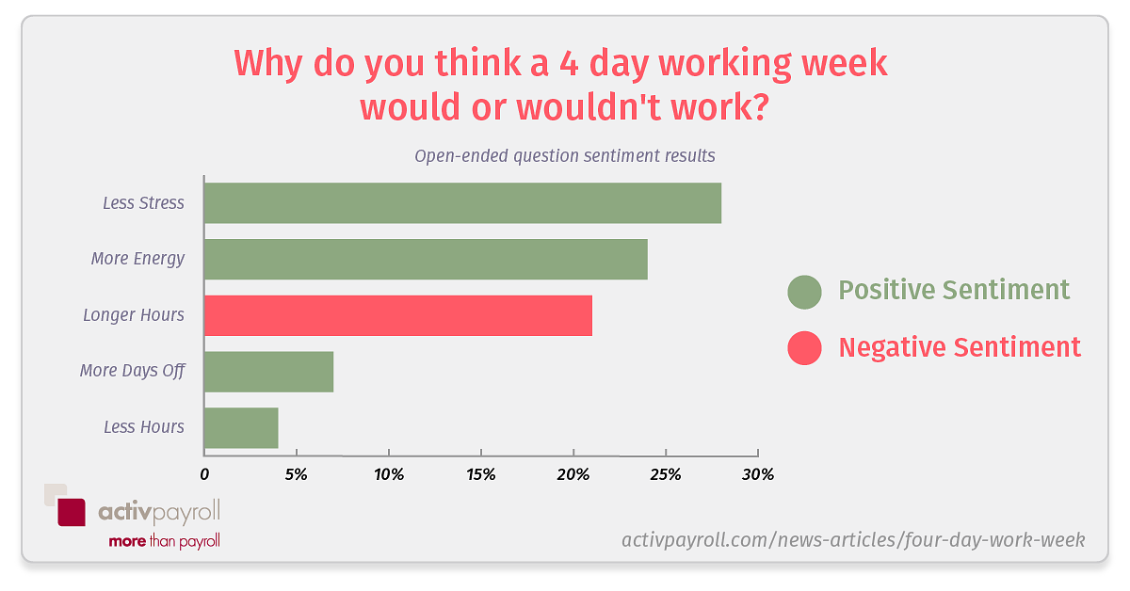
STUDENT SURVEYS:
QUESTIONNAIRES
4. ATTITUDE TOWARDS SCHOOL
-what was your favorite subject in high school
-what was your least favorite subject in high school
-why did you enroll in this class
Source: Norman Herr, Ph.D
CSU, Northridge

Slide 37
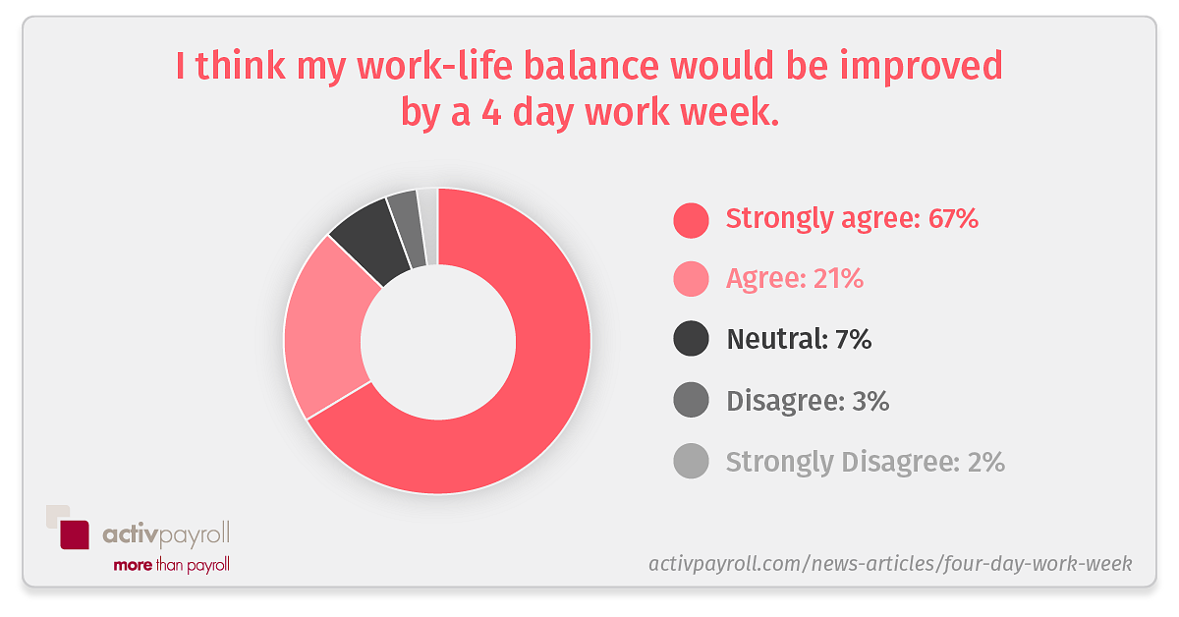
STUDENT SURVEYS:
QUESTIONNAIRES
5. EDUCATIONAL BACKGROUND
-when was your most recent _________ class
-list the _______ courses you have taken
-what is your class schedule
Source: Norman Herr, Ph.D
CSU, Northridge

Slide 38
STUDENT SURVEYS:
QUESTIONNAIRES
6. WRITING ABILITY (Writing prompts)
-I learn the most when the teacher . . .
-My definition of (insert a school subject) is . . .
-My ideal job would be. . .
Source: Norman Herr, Ph.D
CSU, Northridge

Slide 39
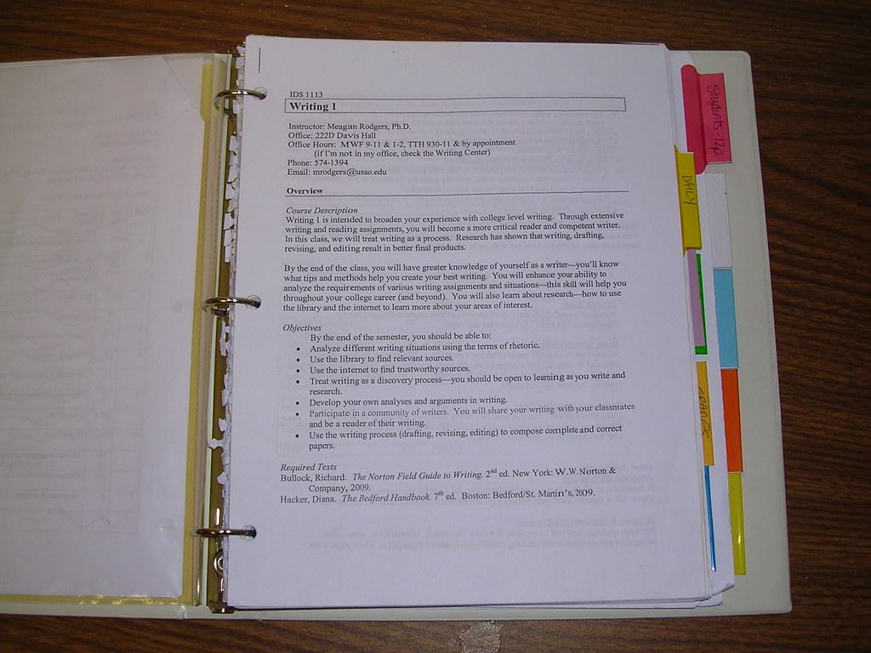
THE SYLLABUS
Dr. Aaron S. Richmond, a professor of Educational Psychology and Human Development at Metropolitan State University of Denver, suggests creating a Learner-Centered Syllabus.
Source: Constructing a Learner-Centered
Syllabus: One Professor’s Journey

Slide 40
THE SYLLABUS
The Purpose of a Syllabus
Viewed as a contract
-rules regarding academic dishonesty
-calendar of course events
-grading policies
Source: Constructing a Learner-Centered
Syllabus: One Professor’s Journey

Slide 41
THE SYLLABUS
The Purpose of a Syllabus
2. Considered a permanent record
-course catalog description
-student learning objectives (SLO’s)
-required readings
Source: Constructing a Learner-Centered
Syllabus: One Professor’s Journey

Slide 42
THE SYLLABUS
The Purpose of a Syllabus
3. Can serve as a cognitive map/learning tool
-provides a visual layout of the course
-explanation of course assignments
-list of assessments
Source: Constructing a Learner-Centered
Syllabus: One Professor’s Journey

Slide 43
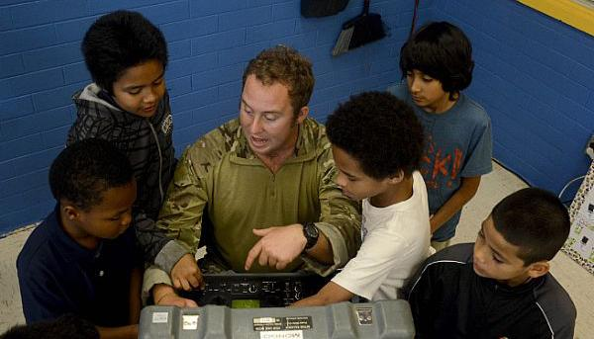
THE SYLLABUS
How to move from a Teacher-Centered Syllabus to a Learner-Centered Syllabus
Establish Community
-accessibility of the teacher
-learning rationale
-collaboration
Source: Constructing a Learner-Centered
Syllabus: One Professor’s Journey

Slide 44
THE SYLLABUS
How to move from a Teacher-Centered Syllabus to a Learner-Centered Syllabus
2. Power and Control
-teacher’s role
-student’s role
-outside resource
-tone and focus of the
syllabus
Source: Constructing a Learner-Centered
Syllabus: One Professor’s Journey

Slide 45
THE SYLLABUS
How to move from a Teacher-Centered Syllabus to a Learner-Centered Syllabus
3. Evaluation and Assessment
-feedback mechanisms
-evaluation
-learning outcomes
-revising/redoing
Source: Constructing a Learner-Centered
Syllabus: One Professor’s Journey

Slide 46
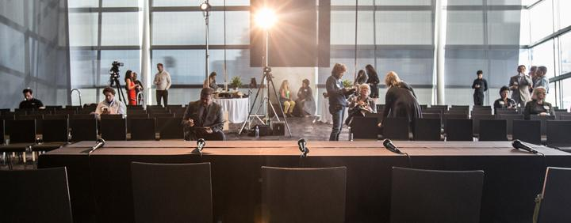
THANK YOU
Contact Information
Toni Bastian
tbastian@ucsd.edu

